Slide 1


MODFLOW 6 Groundwater Flow Model
University of Neuchâtel, Switzerland
Centre for Hydrogeology and Geothermics
December 16-20, 2019
Notes:
Describe some of the ongoing work we are doing with MODFLOW
MODFLOW and related software distributed by the USGS is developed and supported by a growing team of USGS scientists and external collaborators. Recent MODFLOW development efforts have focused on use of unstructured and locally refined grids for constant or variable-density groundwater flow and solute transport simulation, robust handling of three-dimensional anisotropy, generalization and tracking of water transfer between packages, distributed memory parallelization, and consolidation of these core capabilities into MODFLOW 6. These capabilities make it possible to construct new types of models, such as tightly coupled nested models, that have not been possible with previous MODFLOW versions. Underlying these efforts has been the adoption of an open-development philosophy that relies on testing-based development and continuous integration practices by the core development team and by the broader MODFLOW community. Ongoing development increasingly relies on the Flopy python package for automating model construction. Resulting from these development efforts is a suite of MODFLOW programs that can be applied at local, regional, and National scales for a wide variety of complex groundwater flow and transport problems.
OASIS MCT

Slide 2
MODFLOW 6 Framework

Slide 3
MODFLOW 6 Framework Concepts
Simulation
Solution
Model
Packages
Exchanges
Notes:
Groundwater Flow
Transport
Pipe Network
Surface Water Flow
Landscape Hydrology

Slide 4
MODFLOW Framework Components
MODFLOW-2005
MODFLOW 6

Slide 5
Nested Grids
Parent
Child 1
Child 2
Grandchild

Slide 6
Multi-Level Grid Nesting
Notes:
Large scale and fine scale

Slide 7
MODFLOW 6 Framework
Advantages
Disadvantages
Models are independent
Models can have their own resolution
Models can be developed separately
Models can run independently
Models can be tightly coupled at the matrix level
Input and output is standardized
Model / package approach is highly modular and extensible
Platform independent, can run on a supercomputer or a Raspberry Pi
Models must be programmed to work in the framework
Framework primarily tested for groundwater
Framework has been applied to models with an implicit formulation
Framework requires dedicated maintenance and support

Slide 8
MODFLOW 6 Framework Simulation Components
Simulation
Timing Module
Solutions
Models
Exchanges
Utilities
Timing Module
Solution 1
Model 1
Model 2
Model 3
Model 4
Exchange 1
Exchange 2
Exchange 3

Slide 9
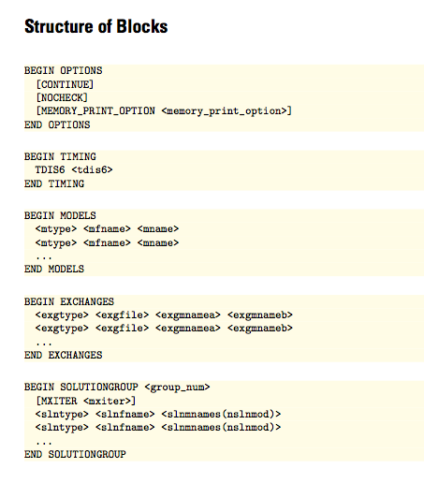
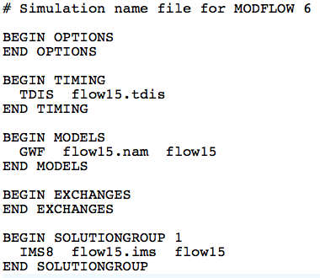
MODFLOW 6 Framework Simulation Name File
Required even for common case with one model
Named mfsim.nam
One simulation per folder

Slide 10
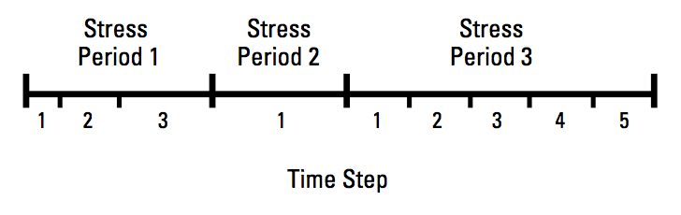
MODFLOW 6 Framework Timing Module
TDIS Package
Uses the MODFLOW concepts of stress periods, time steps
Alternative timing packages may be developed in the future
Timing applies to all models

Slide 11
MODFLOW 6 Framework Stress Period Data
BEGIN OPTIONS
PRINT_INPUT
PRINT_FLOWS
SAVE_FLOWS
END OPTIONS
BEGIN DIMENSIONS
MAXBOUND 42
END DIMENSIONS
BEGIN PERIOD 1
# canal
1 1 1 330.0
1 2 1 330.0
1 3 1 330.0
1 4 1 330.0
...
# river
1 1 20 320.0
1 2 20 320.0
1 3 20 320.0
...
END PERIOD
Stress are active until changed by the user
Different from previous MODFLOW versions
Can be specified using time series

Slide 12
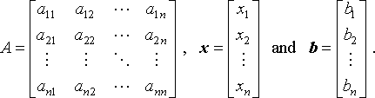
MODFLOW 6 Framework Solutions
Used to solve one or more models and exchanges
The only solution available now is the Iterative Model Solution, or IMS
Unstructured and asymmetric
IMS solves the following nonlinear equation
Ax = b

Slide 13
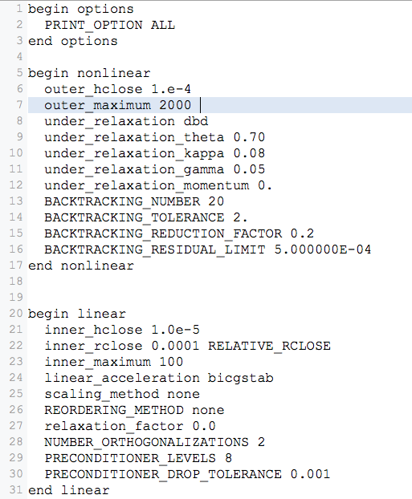
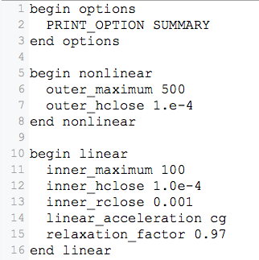
Iterative Model Solution (IMS6)

Slide 14
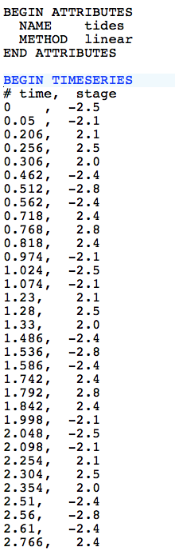
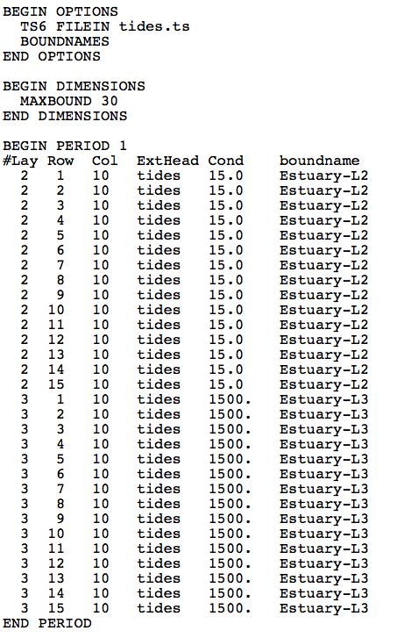
MODFLOW 6 Framework Time Series
tides.ts
GHB Input File

Slide 15
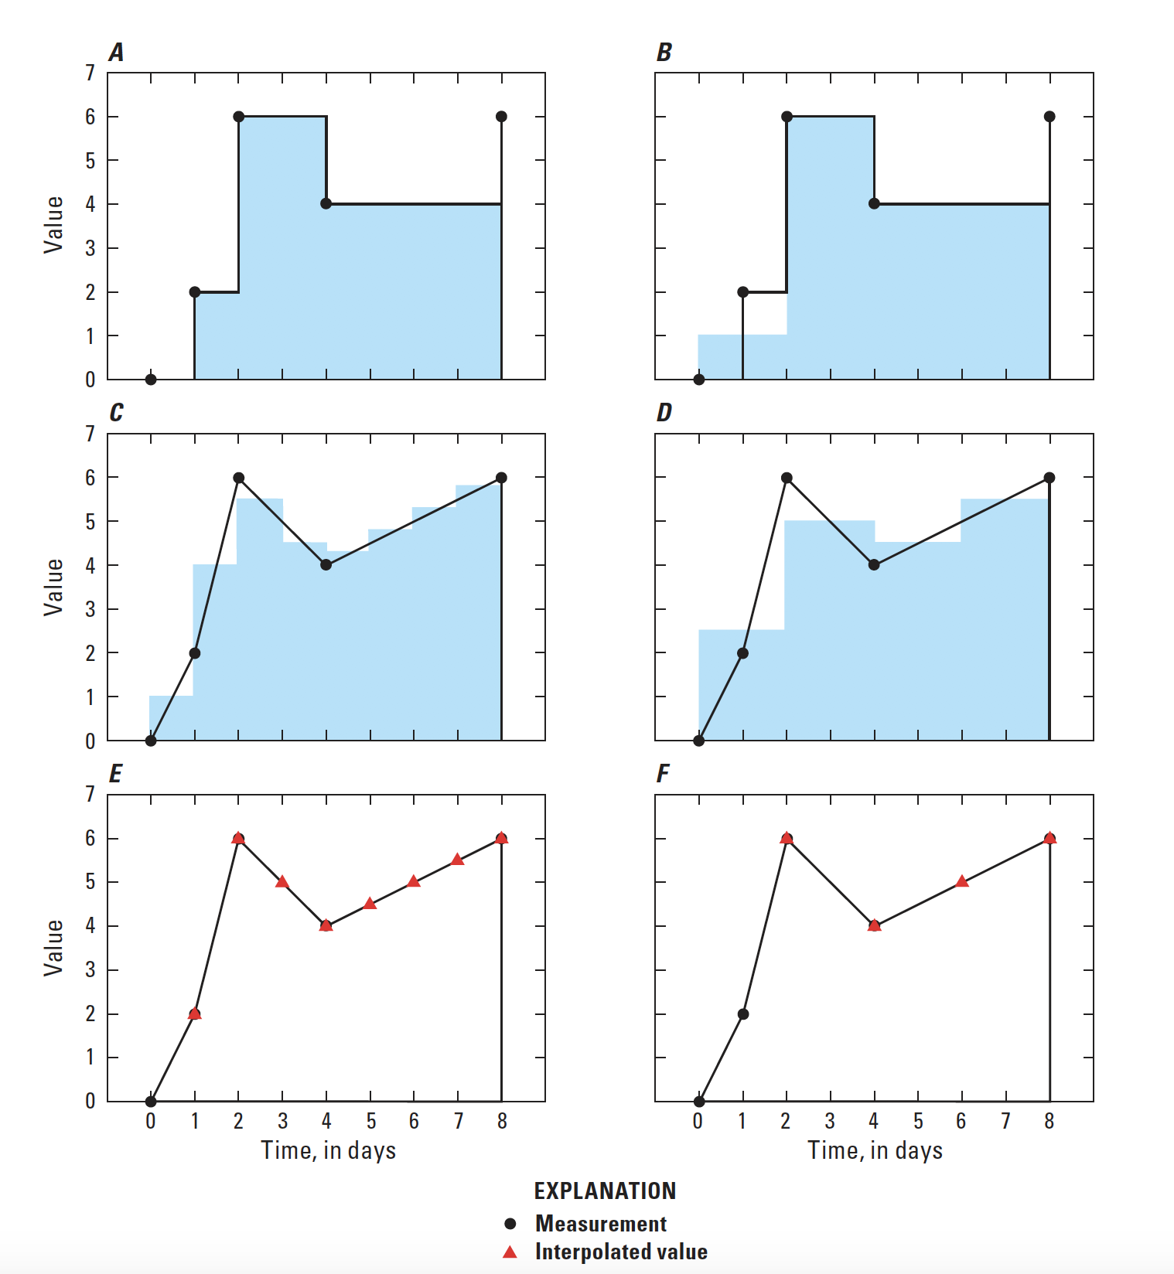
Timeseries Interpolation Methods
STEPWISE
Values are constant until changed
LINEAR
Average value is calculated for the time step
LINEAREND
Value interpolated at end of time step

Slide 16
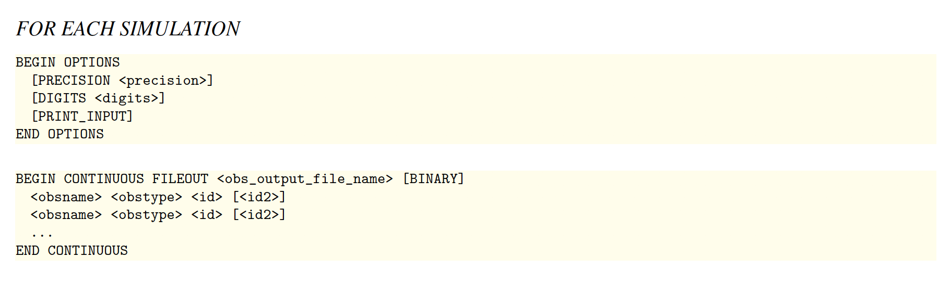
MODFLOW 6 Framework Observations
OBS Package for GWF Model
Heads
Flow between cells
Separate OBS files for each package

Slide 17
Groundwater flow (GWF) model

Slide 18
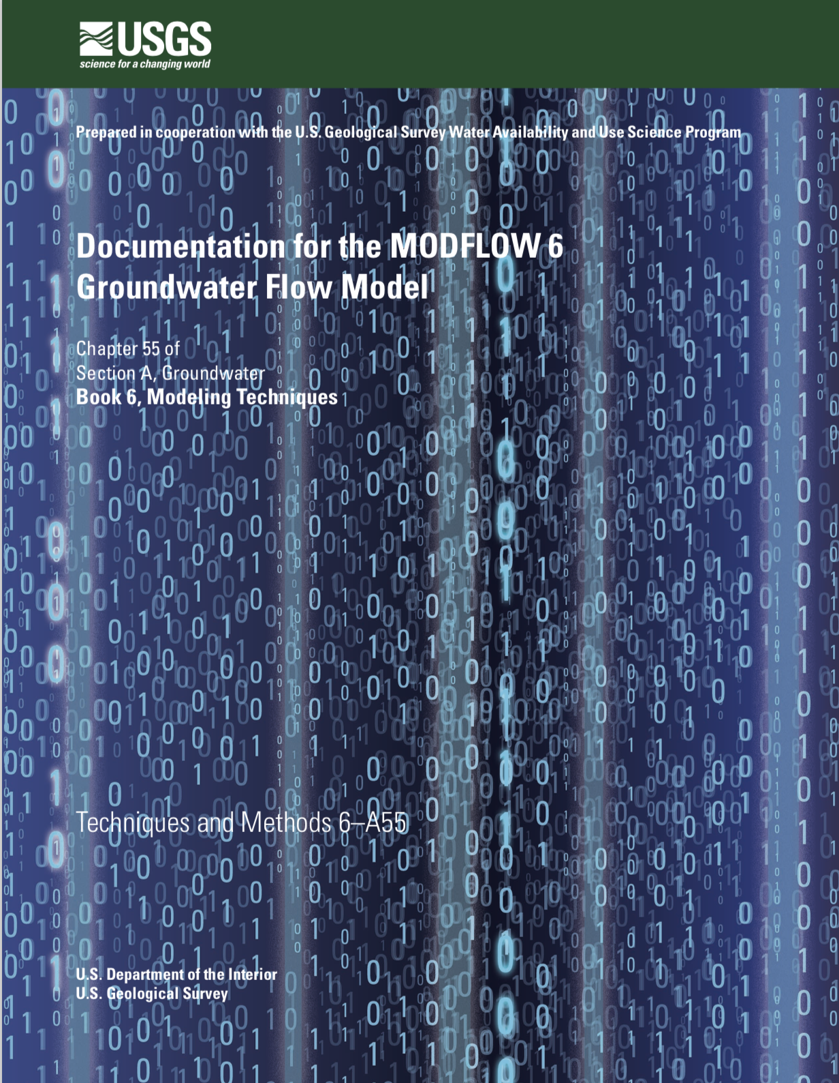
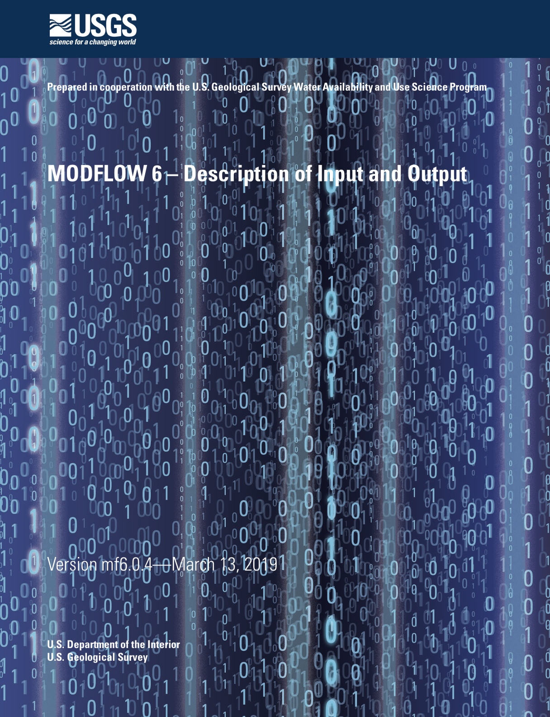
GWF Documentation

Slide 19
GWF Model Highlights
Generalized control-volume finite-difference formulation
Regular MODFLOW grids
Unstructured grids
IDOMAIN capability
Full 3D anisotropy
Multiple stress package ”instances”
Block and keyword input structure

Slide 20
UNDERLYING Formulation

Slide 21
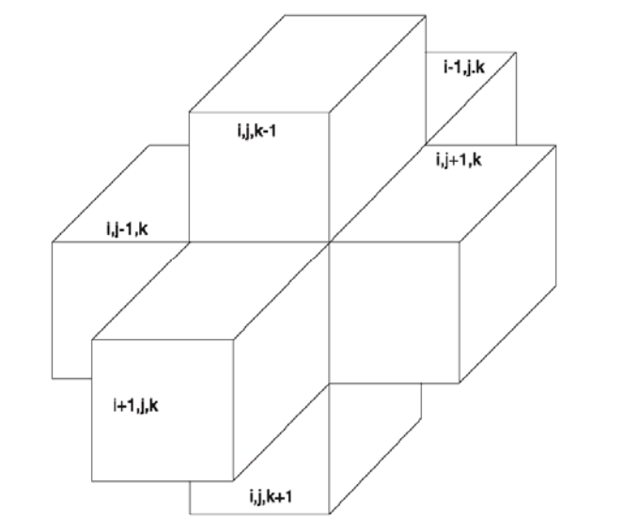
Finite-Difference Equation

Slide 22
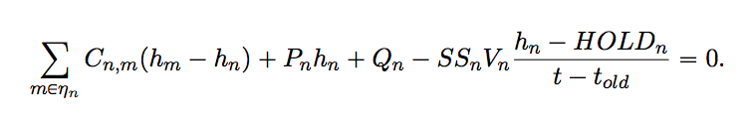
Generalized CVFD Equation

Slide 23
DISCRETIZATION

Slide 24
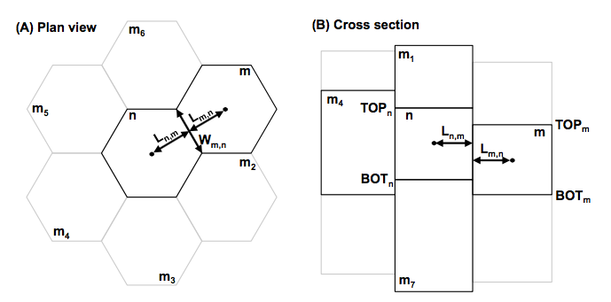
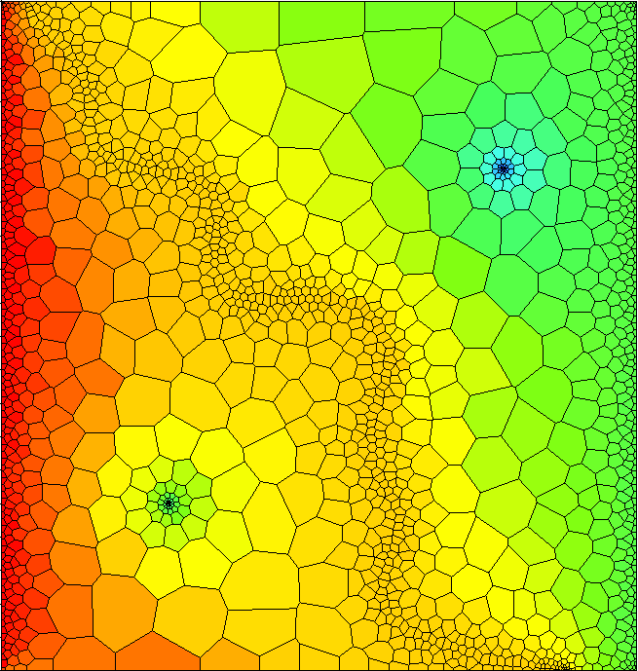
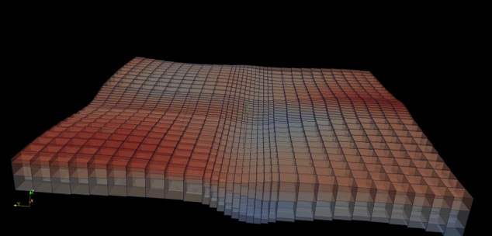
Spatial Discretization
Three ways to enter grid
DIS – regular MODFLOW grid
DISV – discretization by vertices
DISU – fully unstructured

Slide 25
Discretization (DIS) Package
“Regular MODFLOW grid”
Consists of layers, rows, and columns
Top and bottoms can have variable elevations

Slide 26
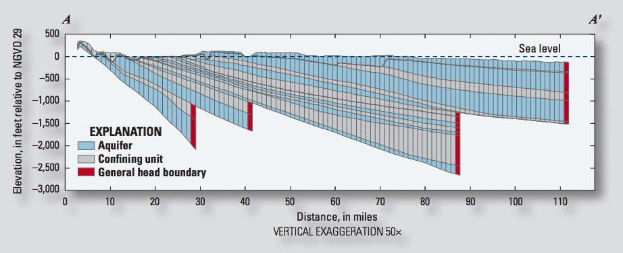
IDOMAIN Capability
Improve efficiency for models with large areas of inactive cells
Address MODFLOW limitations with discontinuous hydrogeologic layers

Slide 27
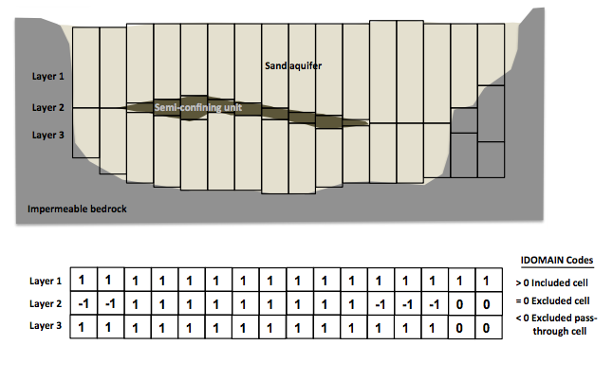
IDOMAIN Capability (cont.)
Permanently remove a cell from the simulation
Can be used with DIS and DISV
Optionally connect overlying and underlying cells

Slide 28
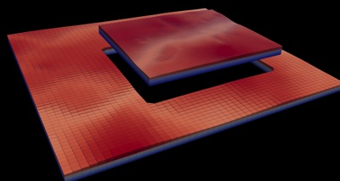
Multi-Model Simulation
MODFLOW 6 foundation allows models to be tightly coupled at the matrix level
Allows local grid refinement (LGR), and other model coupling strategies

Slide 29
LGR Simulation
Simulation
Temporal Discretization
PARENT
C1
C2
GC
Iterative Model Solution

Slide 30
GWF Exchanges
Simulation
Temporal Discretization
PARENT
C1
C2
GC
Iterative Model Solution
PARENT-C1
PARENT-C2
C1-GC

Slide 31
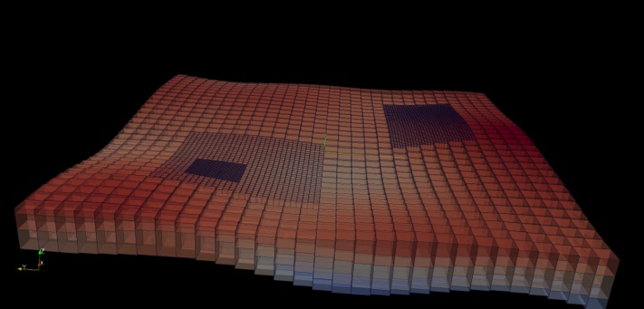
LGR Simulation
Simulation
Temporal Discretization
Simulation Name File
PARENT
BEGIN OPTIONS
END OPTIONS
BEGIN TIMING
TDIS6 mysim.tdis
END TIMING
BEGIN MODELS
GWF6 parent.nam PARENT
GWF6 c1.nam C1
GWF6 c2.nam C2
GWF6 gc.nam GC
END MODELS
BEGIN EXCHANGES
GWF6-GWF6 parent-c1.exg PARENT C1
GWF6-GWF6 parent-c2.exg PARENT C2
GWF6-GWF6 c1-gc.exg C1 GC
END EXCHANGES
BEGIN SOLUTIONGROUP 1
IMS6 mysolver.ims PARENT C1 C2 GC
END SOLUTIONGROUP
C1
C2
GC
Iterative Model Solution
PARENT-C1
PARENT-C2
C1-GC

Slide 32
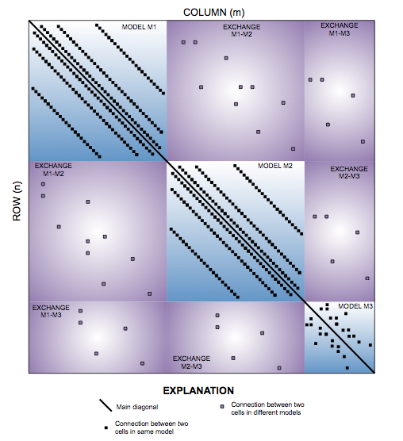
Matrix-Level Coupling
Simulation
Temporal Discretization
PARENT
C1
C2
GC
Iterative Model Solution
PARENT-C1
PARENT-C2
C1-GC
Notes:
Because our solver is unstructured and asymmetric, can handle Newton-Raphson, unstructured grids, ghost nodes, XT3D, dispersion tensors, etc…

Slide 33
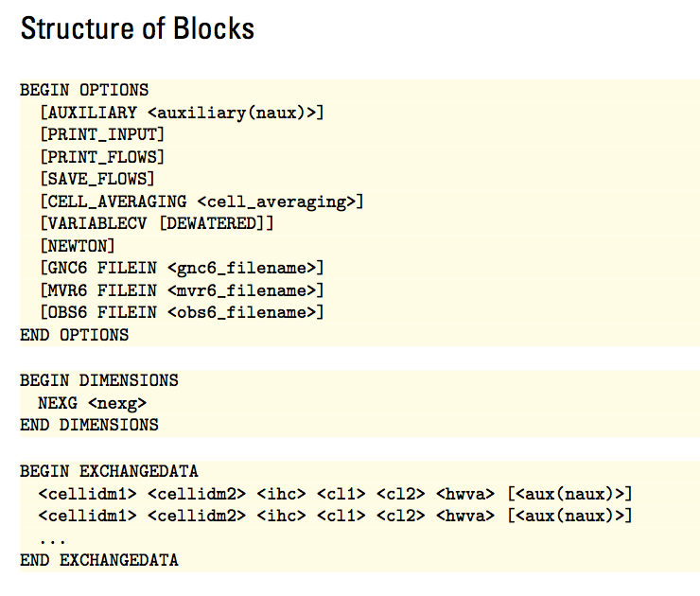
GWF6-GWF6 Exchange

Slide 34
NODE PROPERTY FLOW PACKAGE

Slide 35
Node Property Flow (NPF) Package
Primary purpose is to calculate conductance between adjacent cells
Confined or convertible cells (ICONVERT)
Homogeneous or heterogenous
Isotropic or anisotropic
Handles wetting and drying (REWET, WETDRY) (still available, but the Newton-Raphson method is much better)
Can calculate the three components of specific discharge at the cell center (SAVE_SPECIFIC_DISCHARGE). Nice for vector plots, and required for transport.

Slide 36
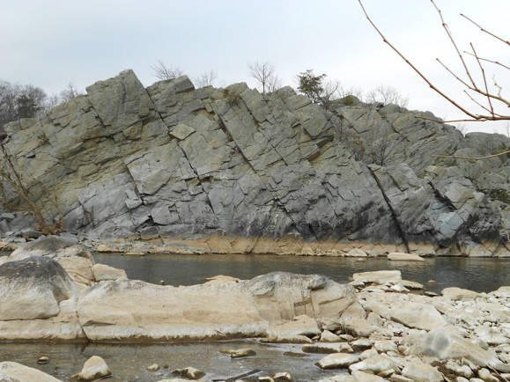
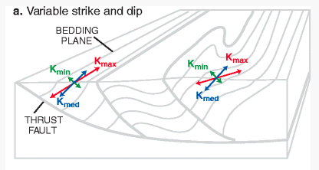
Representation of Anisotropy
Representation of full 3D anisotropy may be required for some problems (fractured aquifers, structurally deformed aquifers)
Some capabilities available (LVDA, SUTRA), but needed generalized CVFD method

Slide 37
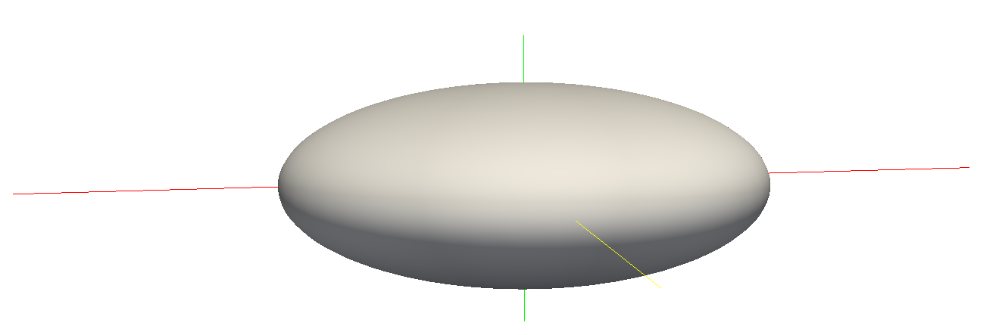
Hydraulic Conductivity Ellipsoid
Defined by three user-provided values on a cell by cell basis
For unrotated case,
K11 = Kx
K22 = Ky
K33 = Kz
K11
K22
K33

Slide 38
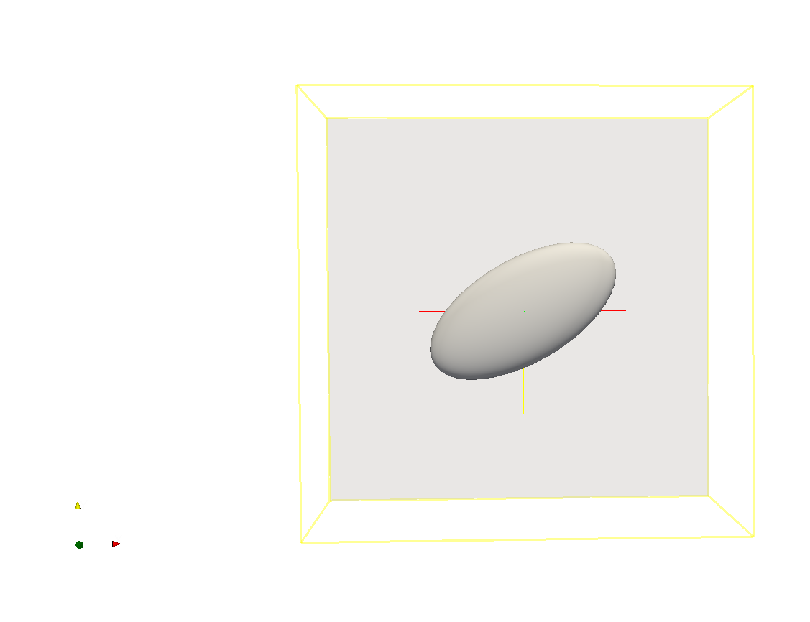
Ellipsoid Rotation
Users can optionally provide ANGLE1, ANGLE2, and ANGLE3 on a cell by cell basis
ANGLE1 is counter-clockwise rotation in the x, y plane

Slide 39
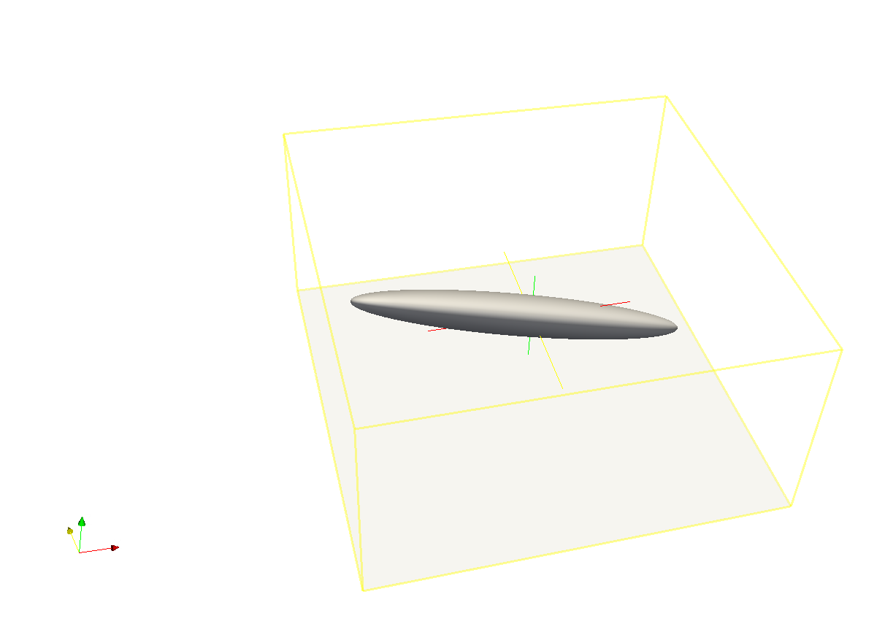
Ellipsoid Rotation (cont.)
All three angles can be specified to represent ellipsoid orientation

Slide 40
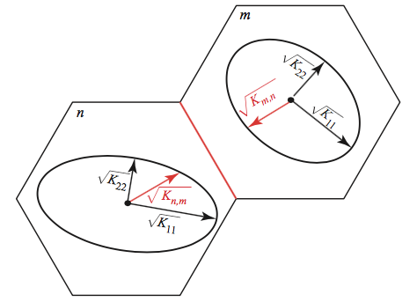
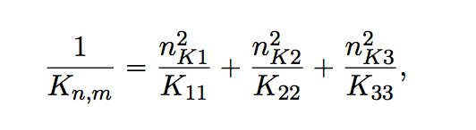
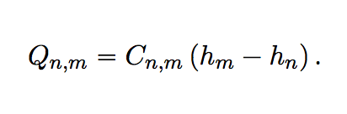
Effective Conductivity Approach
Large errors for certain ellipsoid configurations
Approximate, but relatively fast
Simple to implement

Slide 41
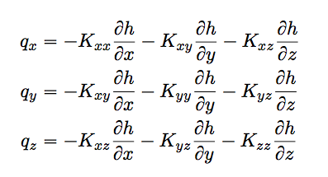
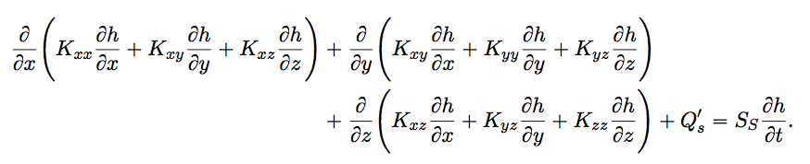
XT3D Approach
General and robust handling of anisotropy
Computationally expensive
Improves flow solution for certain grid types
More on this later

Slide 42
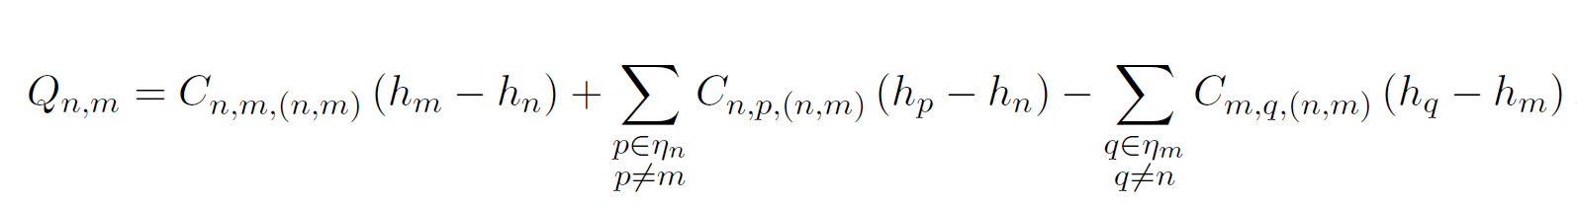
XT3D flow expression
Flow between two cells expressed in terms of conductance-like coefficients that can involve all neighbors of the two cells

Slide 43
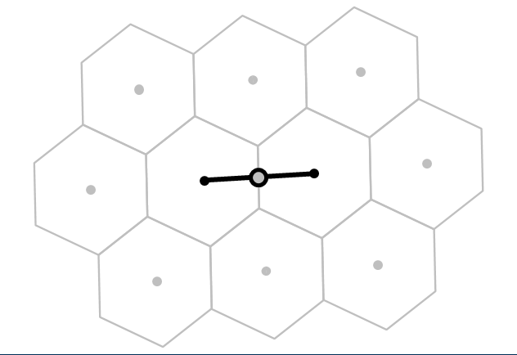
XT3D flow expression
Flow between two cells expressed in terms of conductance-like coefficients that can involve all neighbors of the two cells

Slide 44
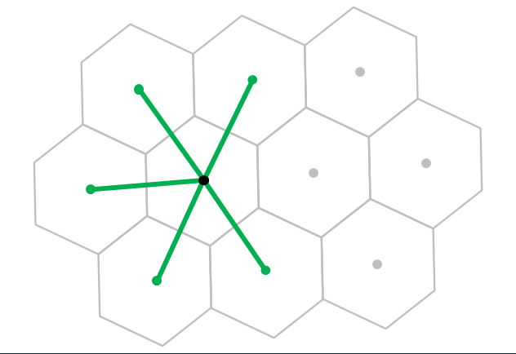
XT3D flow expression
Flow between two cells expressed in terms of conductance-like coefficients that can involve all neighbors of the two cells

Slide 45
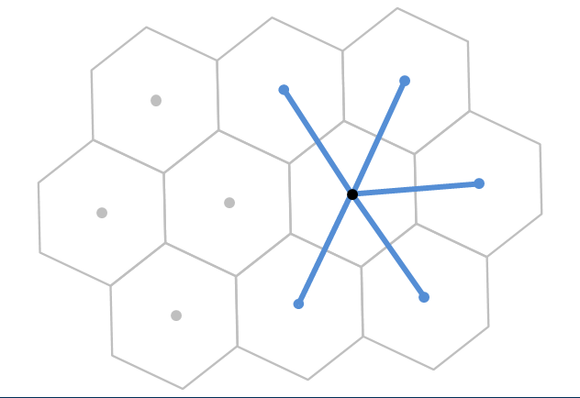
XT3D flow expression
Flow between two cells expressed in terms of conductance-like coefficients that can involve all neighbors of the two cells

Slide 46
XT3D flow expression
Flow between two cells expressed in terms of conductance-like coefficients that can involve all neighbors of the two cells
Larger stencil than in standard conductance-based MODFLOW formulation

Slide 47
XT3D performance
Longer run times than standard MODFLOW formulation
Requires more memory than standard MODFLOW formulation
“RHS” suboption makes memory requirement comparable to default formulation (same stencil)

Slide 48
Newton-Raphson Formulation

Slide 49
Formulation Issues
Originally developed for groundwater flow problems with standard boundary conditions to solve linear (confined) to well-behaved non-linear (unconfined) problems.
Empirical wetting and drying approach added by McDonald and others (1992) to allow cell conversion to simulate more difficult unconfined problems.
Three-dimensional unconfined applications and head-dependent stress packages can create additional nonlinearities.

Slide 50
Wetting/Drying Nonlinearities
Standard Formulation approach:
Dry cells are inactivated. This creates discontinuities and oscillations. Furthermore, wetting/drying results in varying stresses (for example, wells disappear from dry cells).
Newton-Raphson Formulation approach:
Keep all cells active even when the head in a cell is below the bottom of the cell

Slide 51
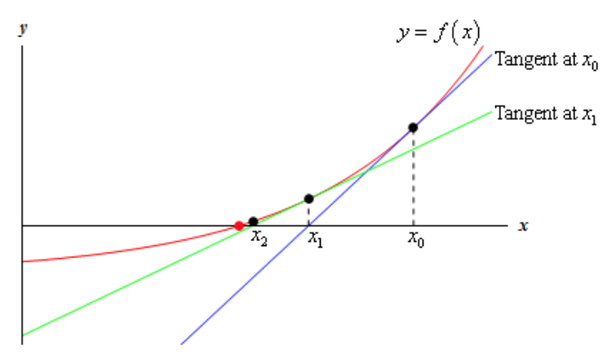
Newton-Raphson method
Standard Formulation:
Newton-Raphson:
Jacobian:
http://tutorial.math.lamar.edu/Classes/CalcI/NewtonsMethod.aspx
Modified Newton-Raphson:

Slide 52
Newton-Raphson Formulation
Conductance transitions from head-dependent to constant
0
Cell
bottom
Cell
top
Transition causes to change from 1 to zero, a discontinuous derivative

Slide 53
Newton-Raphson Formulation
Smooth saturated thickness function over the discontinuity.

Slide 54
Standard Formulation
dry
wet
h_{n} = 90
S_{Fn} = 0
BOT_{n} = 90
h_{m} = 95
S_{Fm} = 5
BOT_{m} = 90
Standard Formulation intercell conductance based on saturated thickness will prevent flow from a wet cell to a dry cell.

Slide 55
Newton-Raphson Formulation
dry
wet
h_{n} = 90
S_{Fn} = 0
BOT_{n} = 90
h_{m} = 95
S_{Fm} = 5
BOT_{m} = 90
Conductance is calculated based on saturated thickness of cell with higher head. Thus, there will be flow from the wet cell to the dry cell.

Slide 56
Newton-Raphson Formulation
Since cells remain active, simulated heads can be less than the cell bottom.

Slide 57
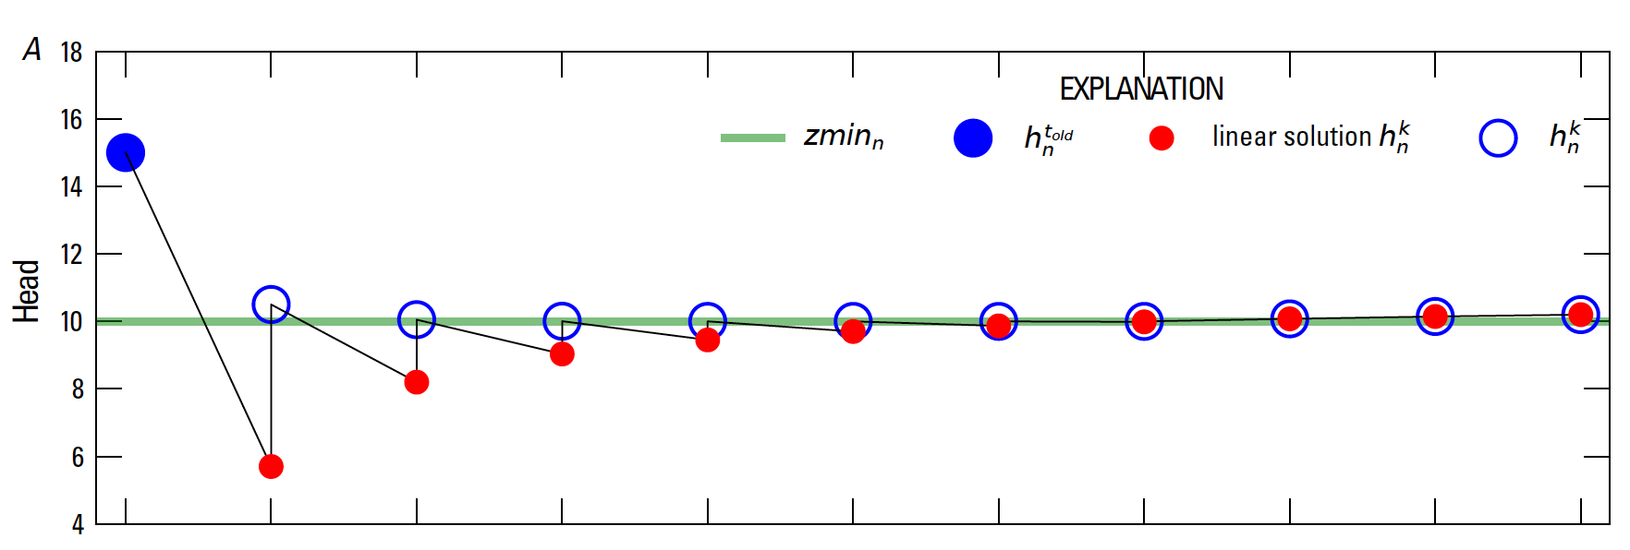
Newton-Raphson Formulation
Under-relaxation for Newton Solutions

Slide 58
Newton-Raphson Formulation
Once Newton-Raphson is enabled in the GWF name file Newton-Raphson is also used for GWF terms formulated by
Storage Package
Well Package (auto flow reduce)
Lake Package*
Multi-aquifer Well Package
Streamflow Routing Package*
Unsaturated Zone Flow Package*
* Stress package continuity equation also solved using Newton-Raphson

Slide 59
Newton-Raphson Formulation
Newton-Raphson formulation is more robust than Picard for strongly non-linear problems.
Newton-Raphson formulation results in a asymmetric matrix.
Asymmetric matrix requires different linear accelerators, line search methods, and under-relaxation methods

Slide 60
Iterative Model Solution (IMS6) Package
Nonlinear methods
Backtracking
Under-relaxation Methods
Simple (equivalent to MODFLOW-2005 PCG package under-relaxation)
Cooley
Delta-Bar-Delta
Pseudo-Transient Continuation for steady-state Newton-Raphson problems

Slide 61
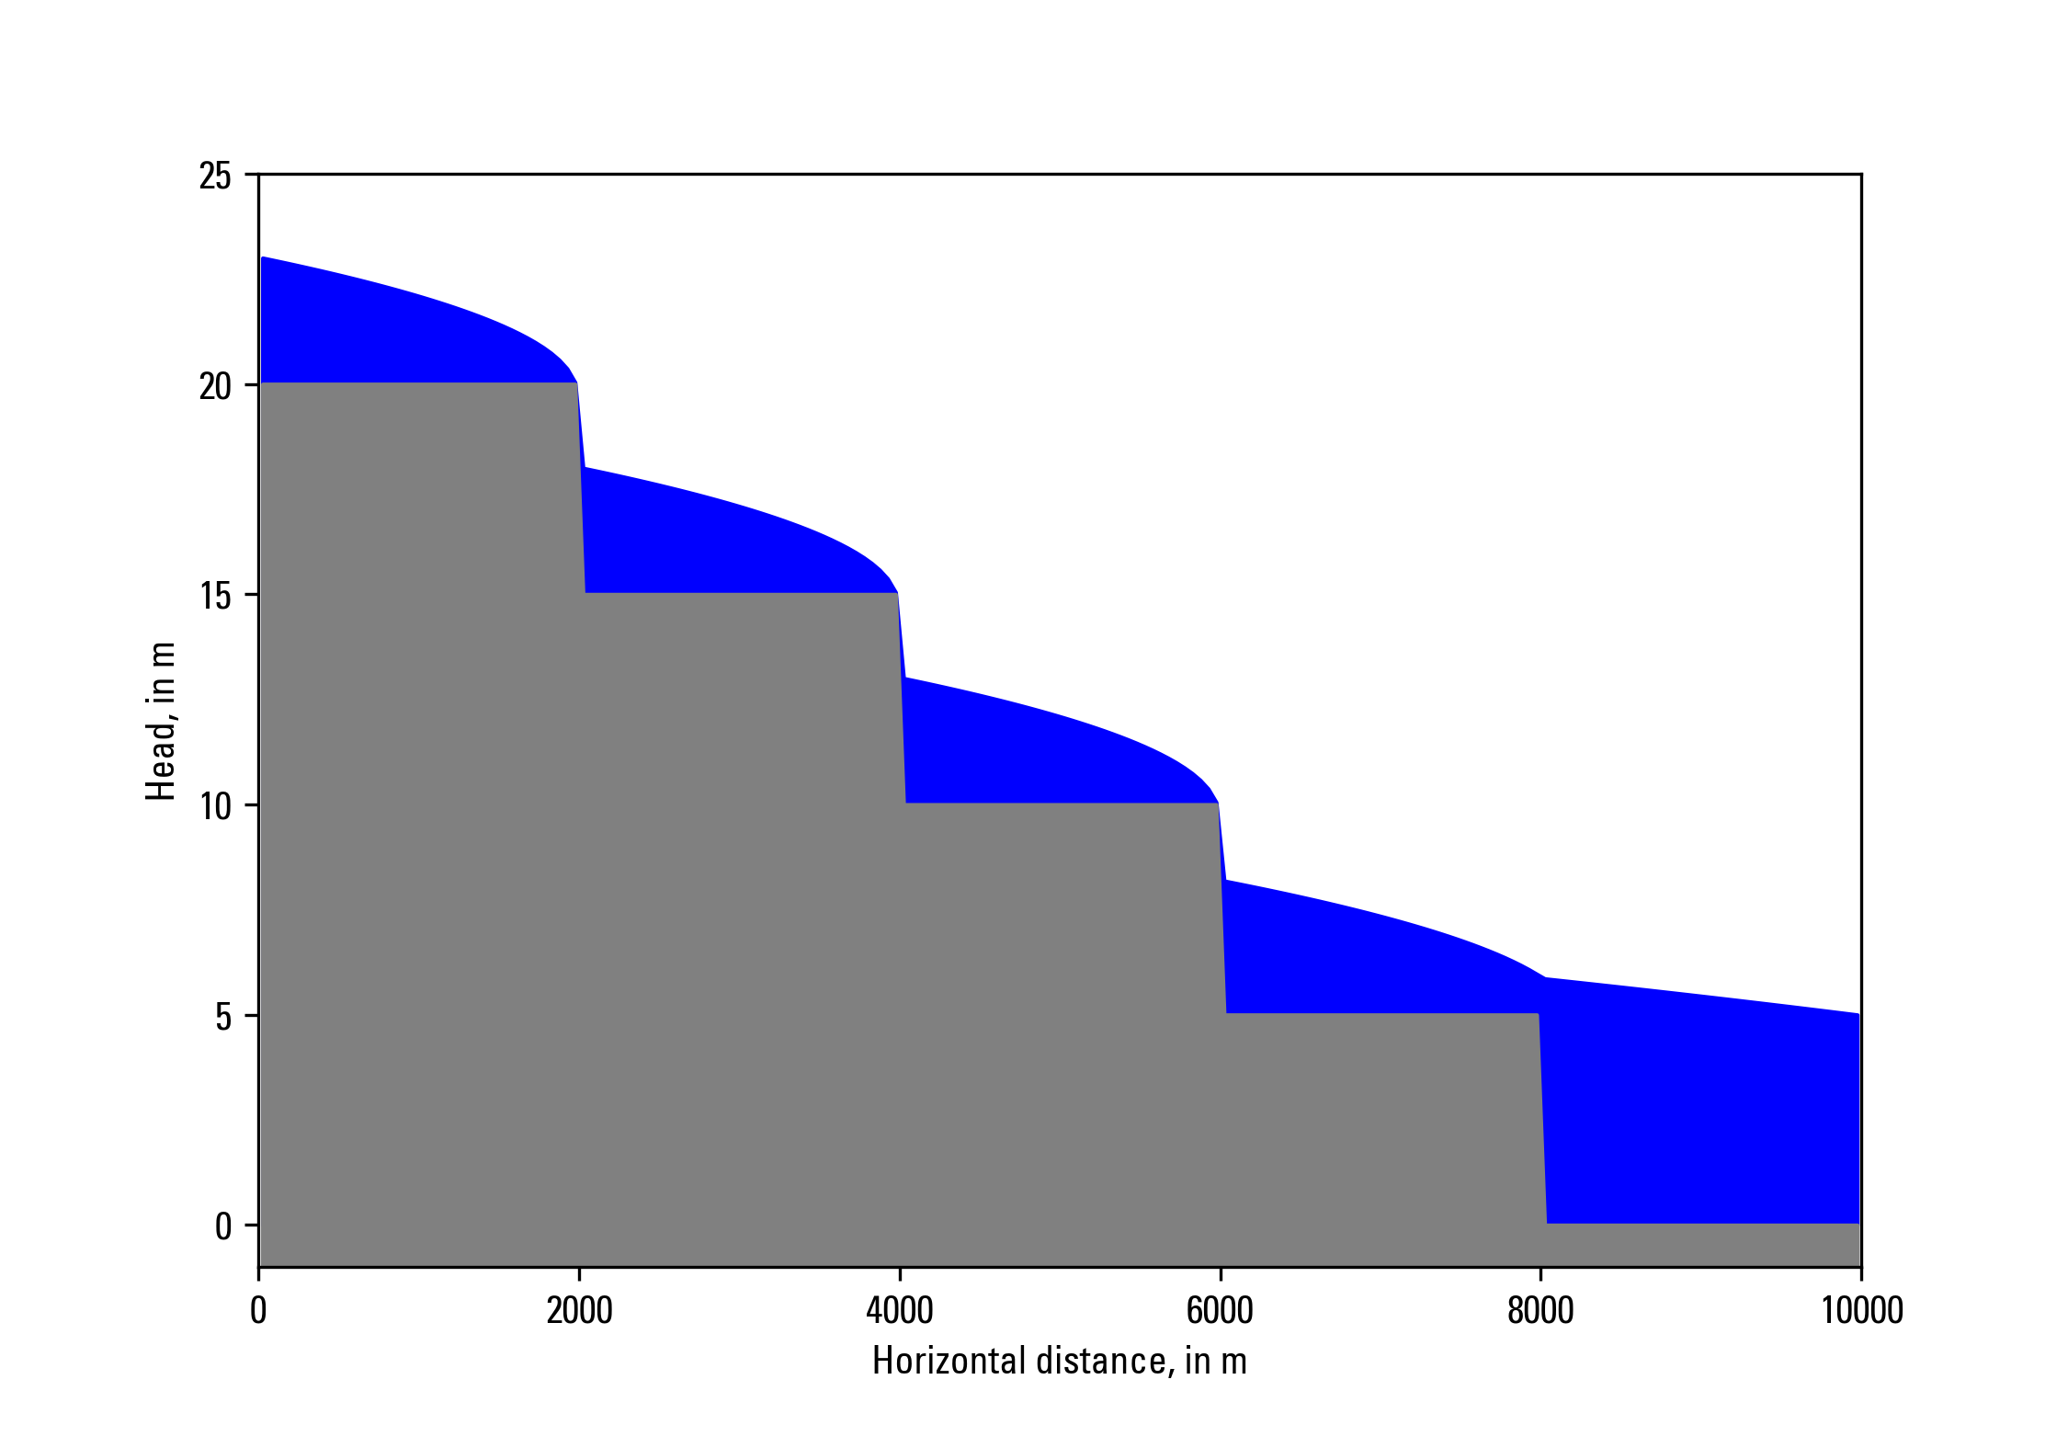
Newton-Raphson Formulation
Zaidel, Jacob, 2013, Discontinuous steady-state analytical solutions of the Boussinesq equation and their numerical representation by MODFLOW: Groundwater, v. 51, p. 952–959. doi: 10.1111/gwat.12019.

Slide 62
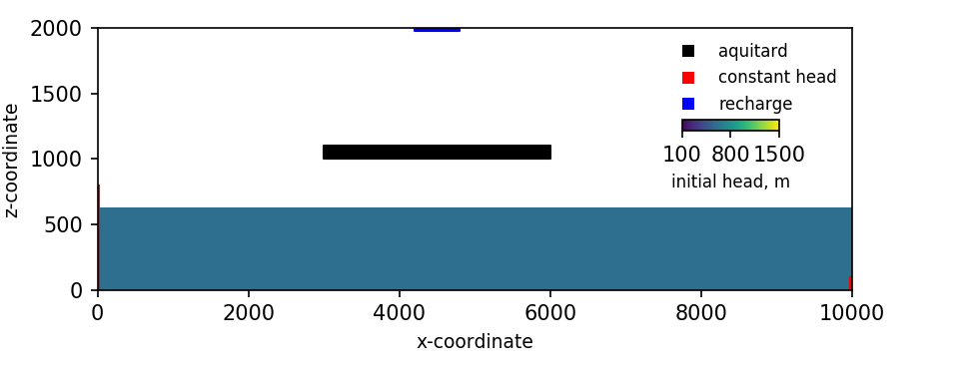
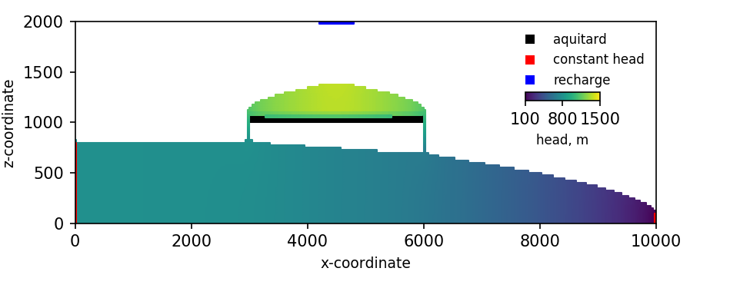
Newton-Raphson Formulation
Keating, Elizabeth, and Zyvoloski, George, 2009, A stable and efficient numerical algorithm for unconfined aquifer analysis: Ground Water, v. 47, no. 4, p. 569–579, accessed June 27, 2017, at https://doi.org/10.1111/ j.1745-6584.2009.00555.x.

Slide 63
storage

Slide 64
Storage (STO) Package
Steady state if STO Package not specified for a simulation
Cells are treated as confined or convertible (ICONVERT)
Aquifer storage properties (SS and SY) are specified
Individual stress periods are marked as steady state or transient

Slide 65
Skeletal Storage, Compaction and Subsidence (Csub) Package

Slide 66
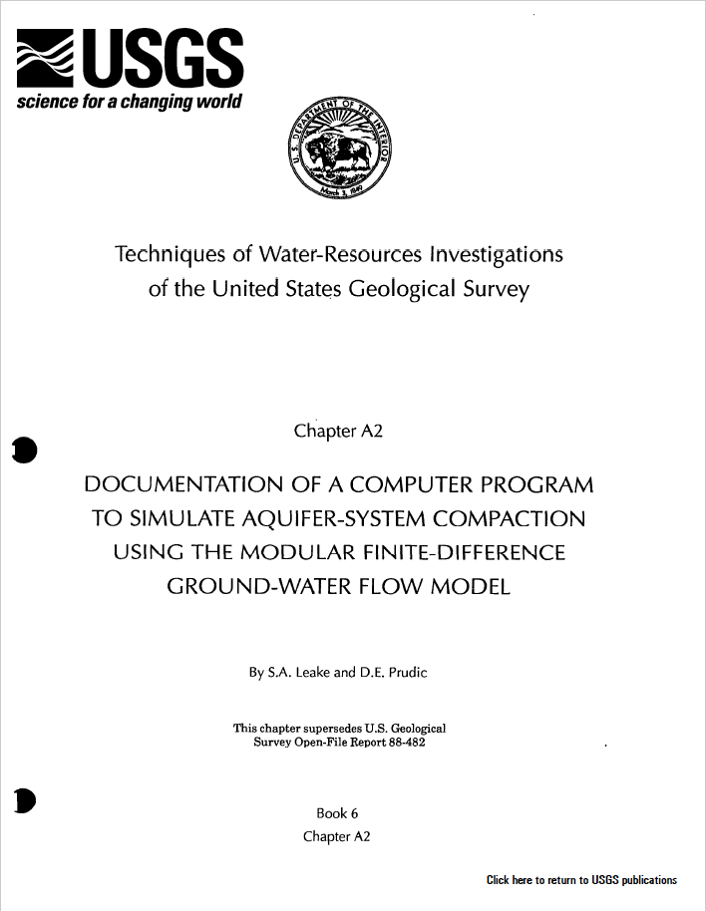
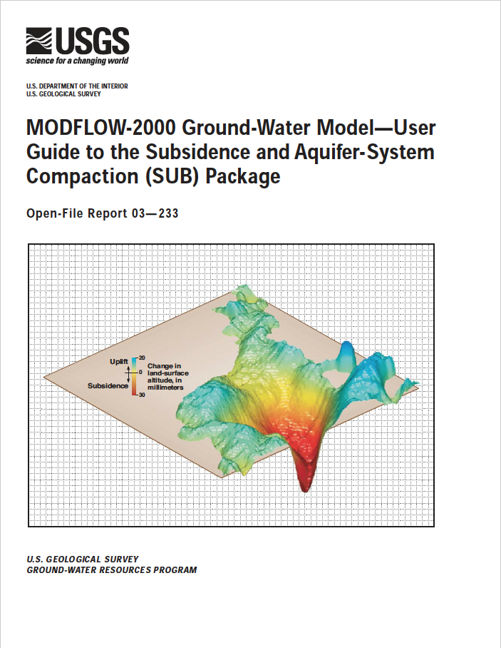
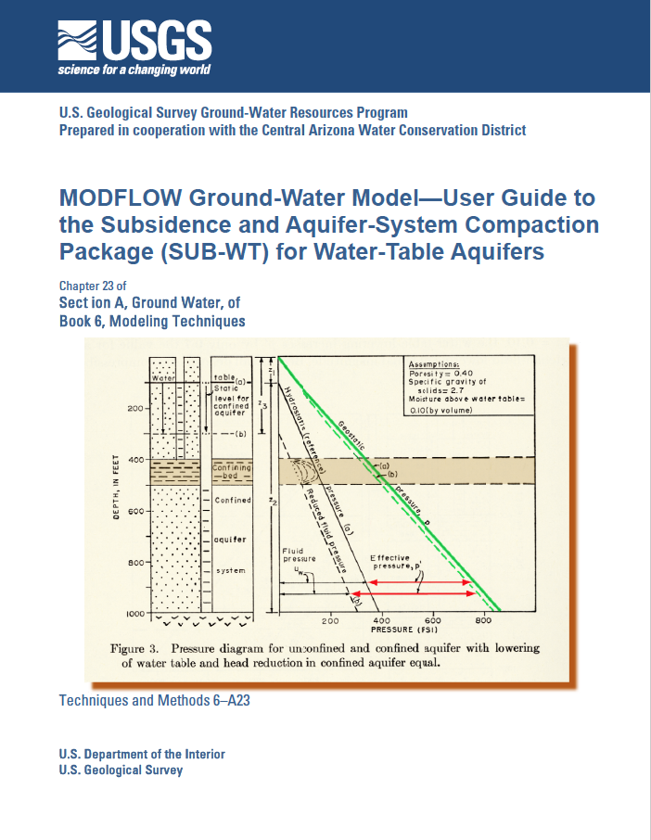
Previous subsidence package versions

Slide 67
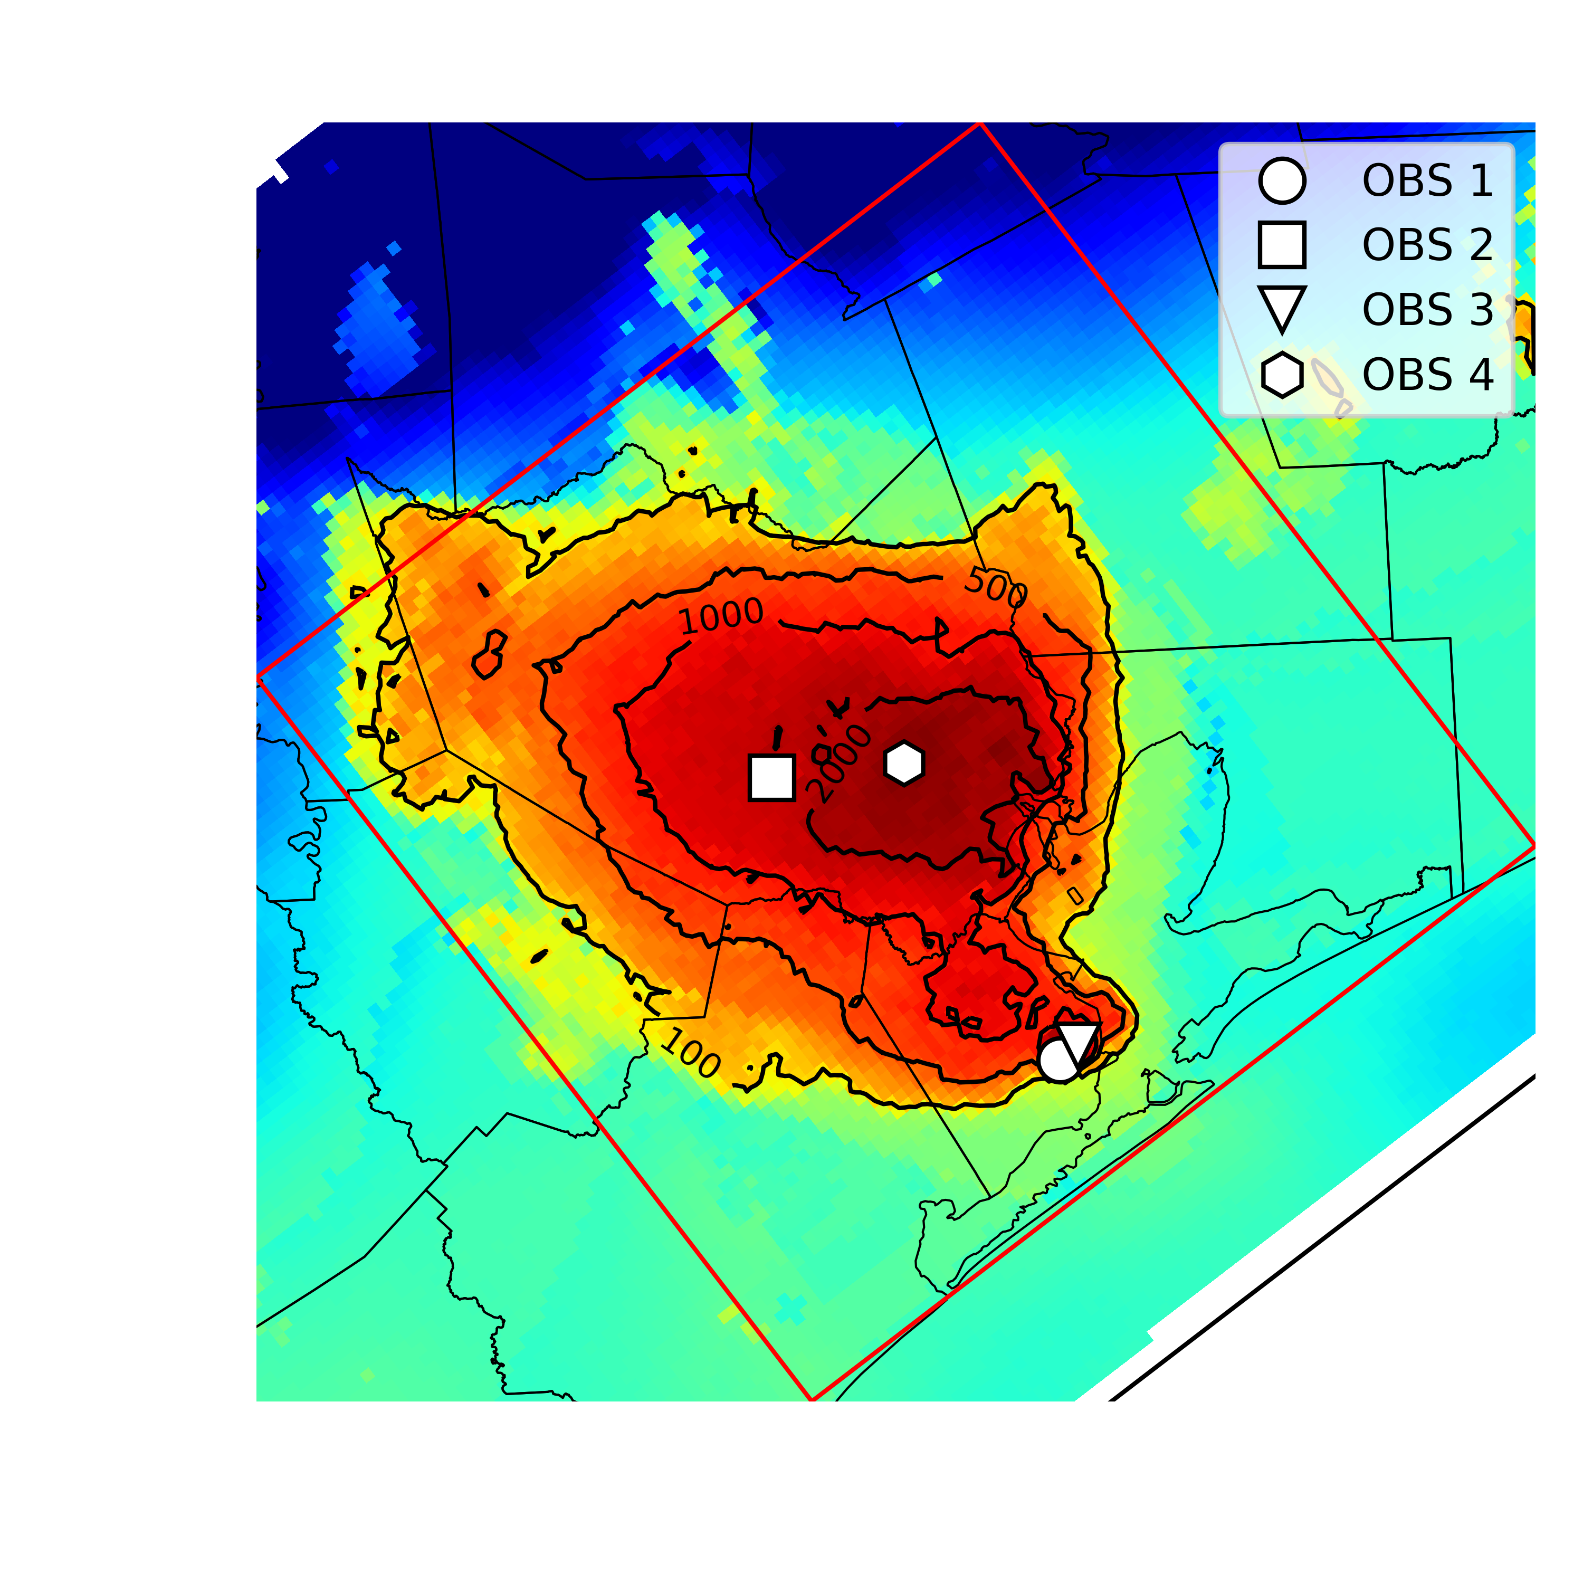
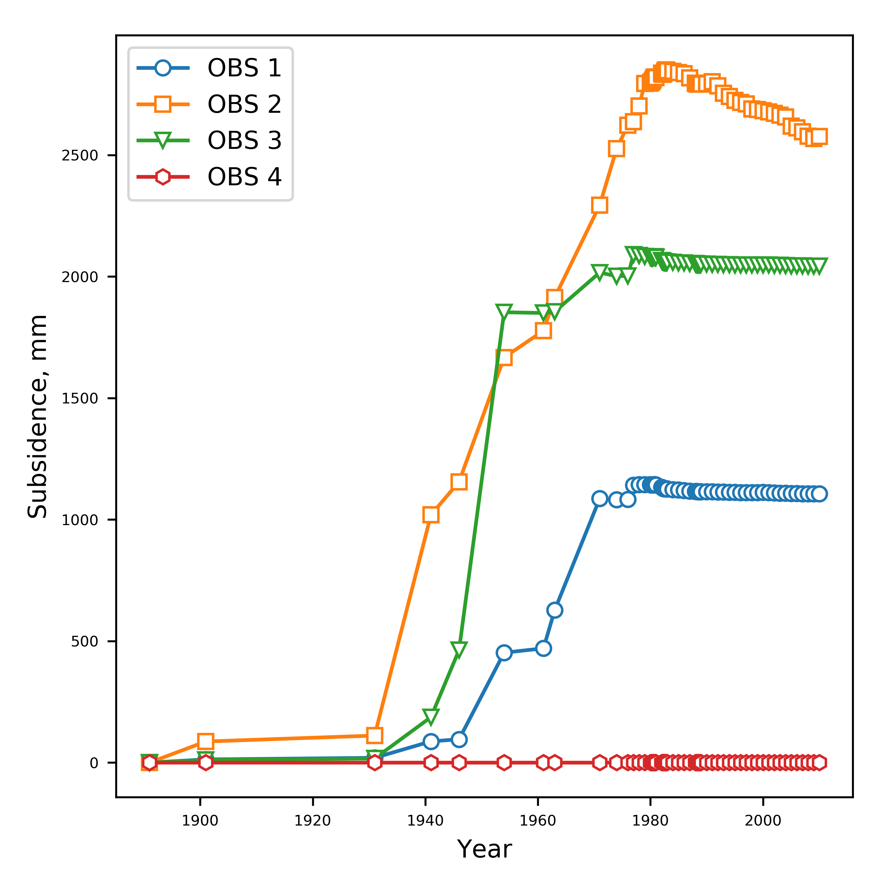
CSUB Package – Capabilities
Package based on MODFLOW-2005 SUB and SUB-WT Packages
Effective stress formulation
Effective stress dependent storage properties
Water table dependent compaction
Elastic and inelastic compaction of fine-grained sediments
No-delay (thin beds that equilibrate quickly)
Delay (thick beds that drain slowly – separate numerical solution)
Can account for elastic compaction of coarse-grained aquifer materials and water compressibility (full storage equation)

Slide 68
CSUB Package – theory
Assuming compaction is predominantly vertical
where

Slide 69
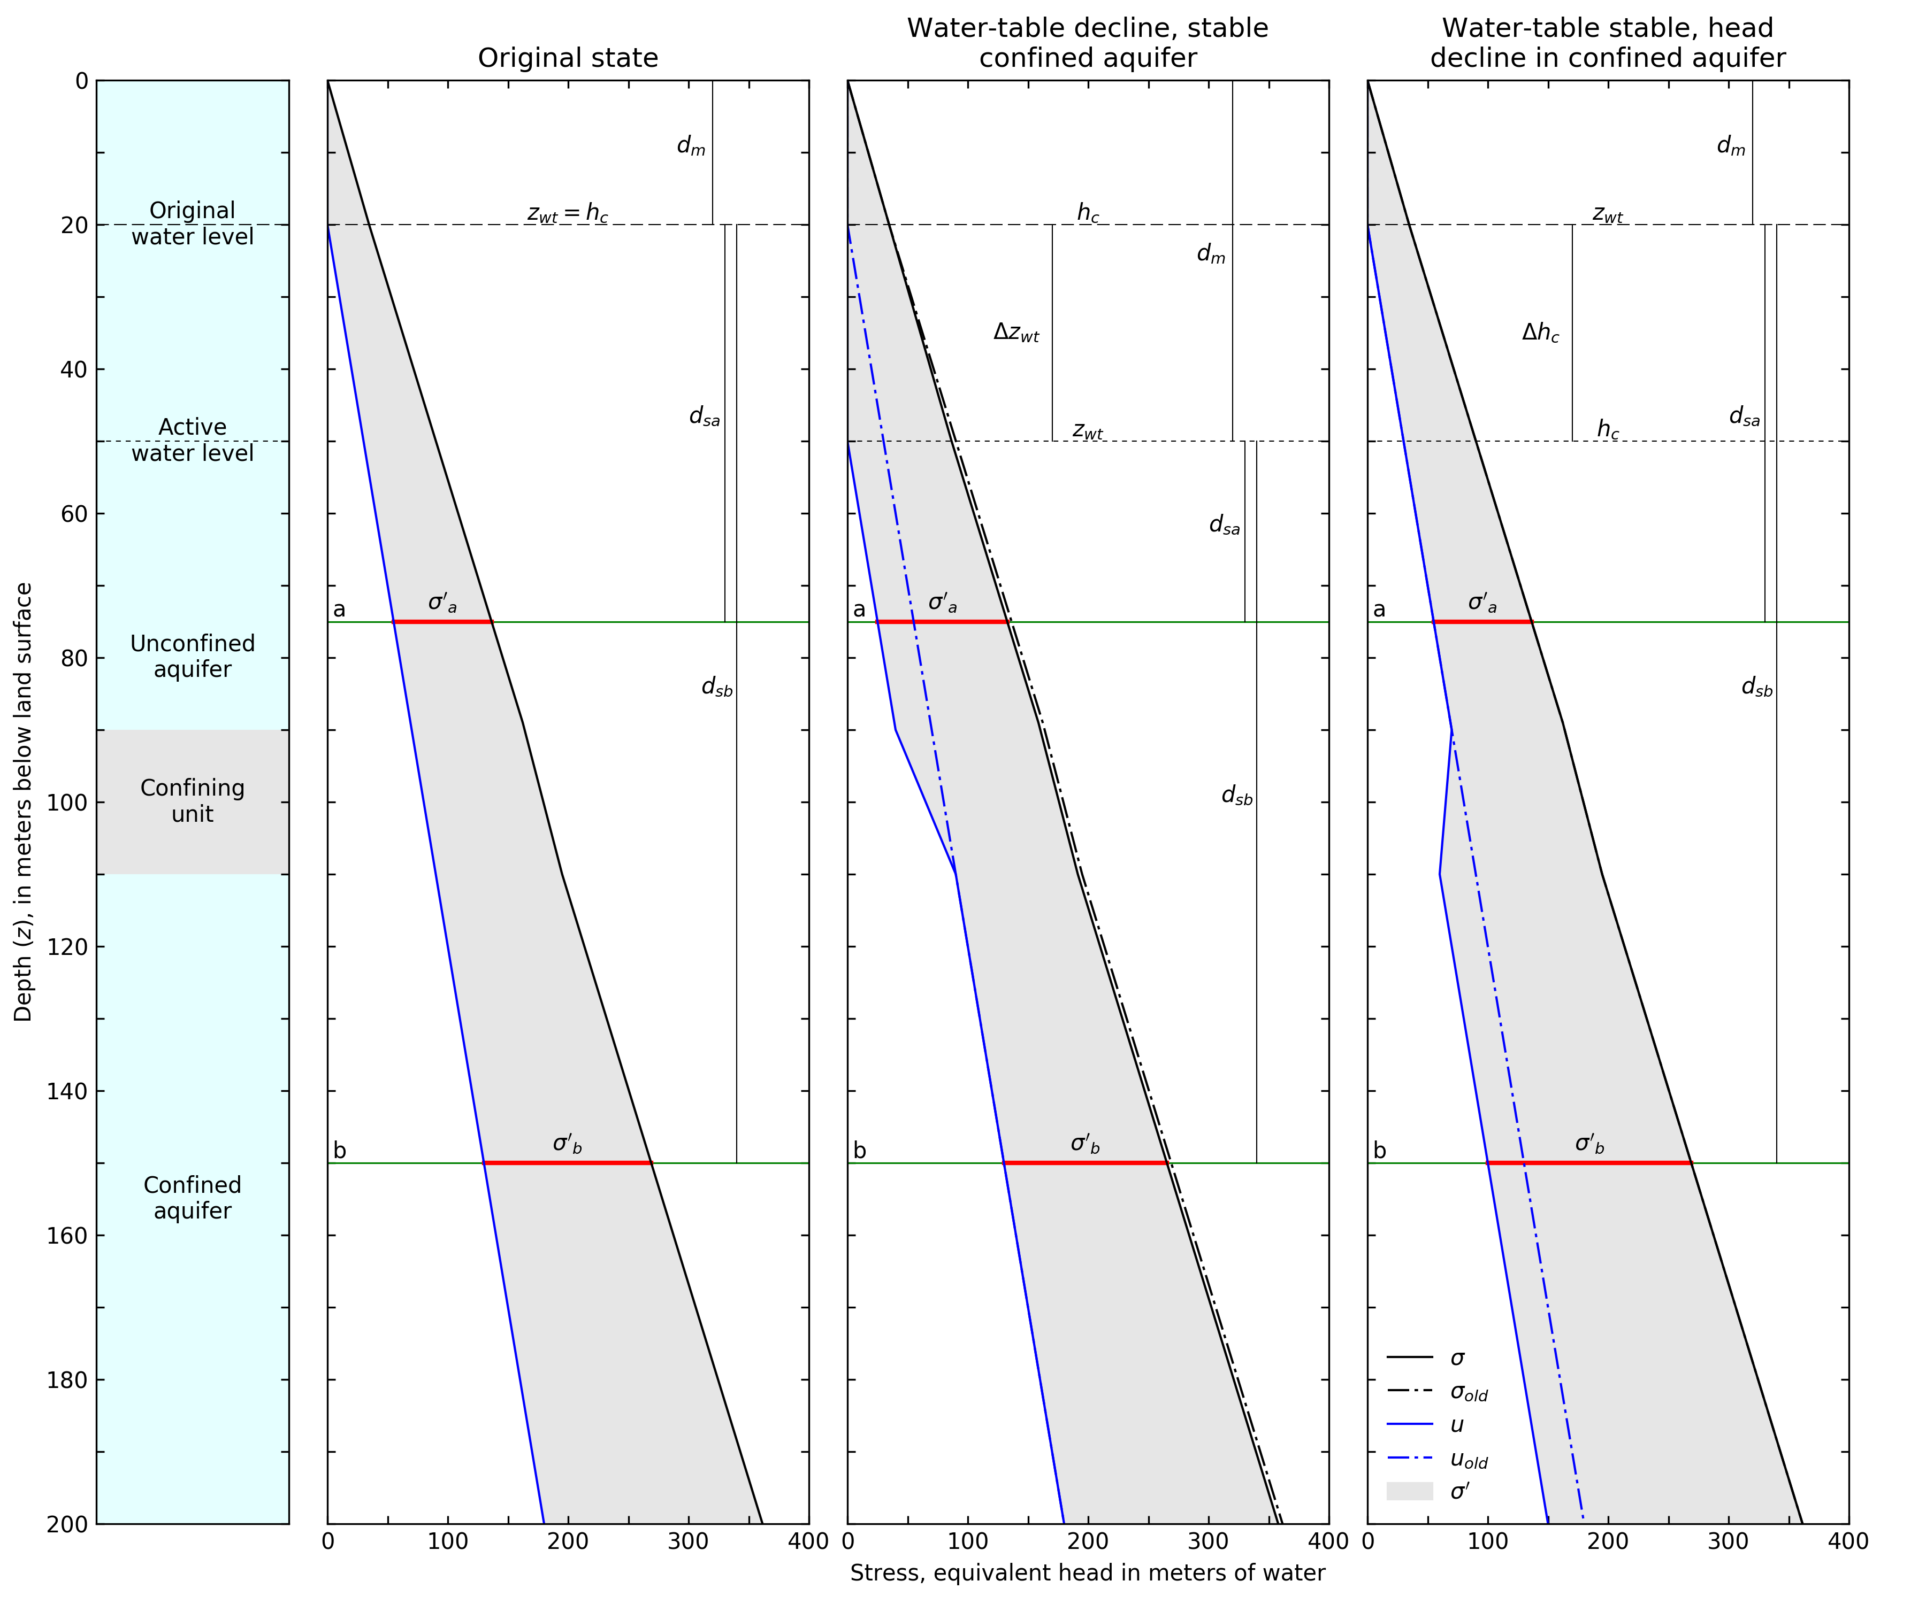
CSUB Package – theory

Slide 70
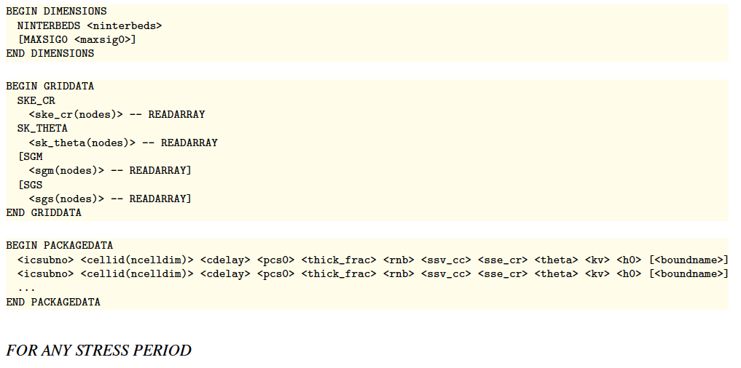
CSUB Package – input

Slide 71
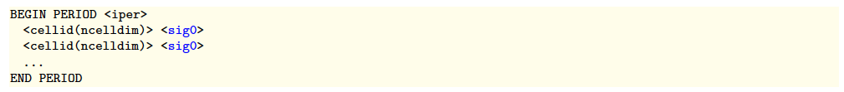
CSUB Package – input options
Head-based formulation
Compaction dependent porosity/void ratio and thickness for no-delay beds
Specify interbed thickness as a fraction of cell thickness
Time-varying geostatic stress above model

Slide 72
One-dimensional column problem simulating extensometer observations
Sneed (2008) model used head-based formulation (SUB package)
Combination of no-delay and delay interbeds
Elastic compressibility of coarse-grained materials and water compressibility simulated
Specified water-levels used to simulate historic water-level changes
Calibrated using PEST++
Calibrated to simulated compaction from head-based results
Calibrated inelastic specific storage with tied elastic specific storage and original multiplier
Coarse-grained elastic specific storage insensitive

Slide 74
Traditional stress packages

Slide 75
Traditional Packages
Specified head (CHD) Package
No more IBOUND. Must use CHD
Can turn CHD cells on and off by stress period
Well (WEL) Package
Recharge (RCH) Package
Array-based or list based
River (RIV) Package
General-Head Boundary (GHB) Package
Drain (DRN) Package
Evapotranspiration (EVT) Package
Array-based or list based

Slide 76

All GWF Packages

Slide 77

Multiple Package of Same Type

Slide 78
QUESTIONS?

